Slide 1



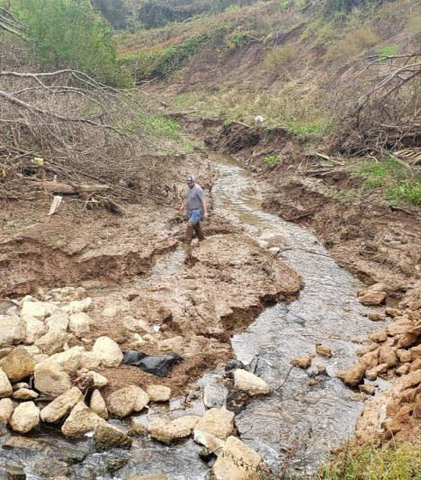
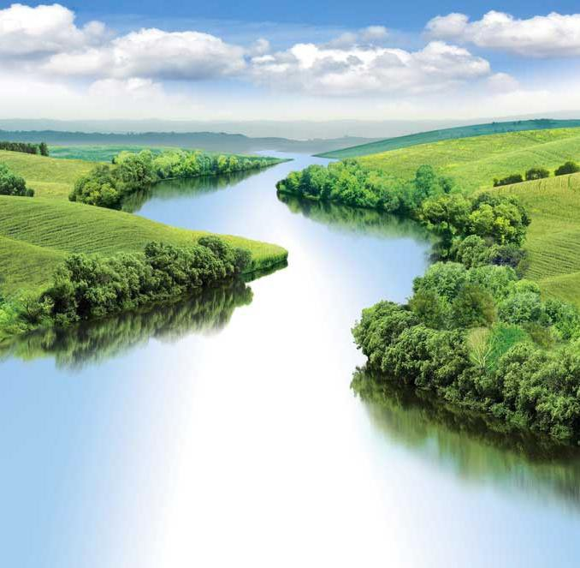



WATER QUALITY MODELING
UNCLASSIFIED
Todd Steissberg
U.S. Army Engineer Research and Development Center, Environmental Laboratory
CE-QUAL-W2 Workshop, 2024
July 08-09, 2024
Environmental Systems
Modeling Team
UNCLASSIFIED
DISCOVER | DEVELOP | DELIVER
1

Slide 2

Outline
Important Terms
Water Quality Definition
Conceptual Model
Assumptions
Mass Balance
Conservative
Complete Process Representation
Boundary Conditions
Initial Conditions
Water quality capabilities
State variables
Derived variables
WQ processes

Slide 3
Important Terms
State Variables: Fundamental variables in a model that describe the state of the system at any given time. These variables are intrinsic to the system and are typically governed by differential equations representing the physical, chemical, or biological processes. In other words, they are incorporated into the advection-diffusion and transformation processes.
Examples: Concentrations of various substances (e.g., nutrients like nitrogen and phosphorus, dissolved oxygen, temperature, microbial populations).
Derived Variables: Calculated from the state variables and other known quantities within the system. They provide additional insights or outputs that are not directly modeled by the state equations but are important for interpreting the system's behavior.
Examples: Saturation levels of dissolved oxygen (derived from temperature and oxygen concentration), water quality indices (calculated from various state variables), and total suspended solids (which might be derived from measurements of turbidity and flow rates), and Total Dissolved Gas (TDG, derived by summing dissolved oxygen and nitrogen)

Slide 4
Important Terms, Continued
Conservative Constituents: Do not undergo any chemical, biological, or physical transformation as they move through the system. Their concentration changes only due to dilution, mixing, or advection.
Examples: Chloride, sodium, and other non-reactive tracers or substances. These substances can be used to track water movement and mixing patterns without altering their properties.
Non-Conservative Constituents: Undergo chemical, biological, or physical transformations as they move through the system. Their concentration changes due to processes such as chemical reactions, biological uptake or release, and physical transformations.
Examples: Nutrients like nitrate and phosphate (subject to biological uptake and transformation), organic matter (subject to decomposition), and pollutants like heavy metals (which can adsorb to sediments or precipitate).

Slide 5
Water Quality
Water quality is agglomeration of physical, chemical, and biological components of water column that determine its overall “condition.”
Physical components include temperature and suspended solids and conservative dissolved
substances.
Chemical components include dissolved substances whose levels are impacted by physical,
chemical , and biological processes (non-conservative).
Biological components are living organisms whose normal biological processes are impacted by and have impacts on the conditions present in the water column.

Slide 6
Conceptual Water Quality Model
^{Q}in
^{Q}out
C
C
^{C}in
V
𝑑𝑉
= σ 𝑄𝑖𝑛 - σ 𝑄𝑜𝑢𝑡
𝑑𝐶𝑉
𝑑𝑡
= σ 𝑄𝑖𝑛 𝐶𝑖𝑛 - σ 𝑄𝑜𝑢𝑡 𝐶
+ 𝑟 𝑉
kinetic transformations
𝑑𝑡
change in mass over time
total inflow of mass
total outflow of mass

Slide 7
CE-QUAL-W2 Water Quality
∂⎛⎜ BD ^{∂Φ⎞}⎟
∂⎛⎜ BD ^{∂Φ⎞}⎟
∂ BΦ ∂ UBΦ ∂ WBΦ
⎝
^{x} ∂ x ⎠
⎝
^{z} ∂ z ⎠
+ +
-
-
= q_{Φ} B +
SΦ B
∂ t ∂ x ∂ z
∂ x
∂ z
y=y₂
Kinetics
c
Laterally averaging
c
y=y₁

Slide 8
Mass Balance
Mass of all substances in model is conserved, not created nor destroyed.
Mass can be transformed from one form to another (i.e., Nitrogen from NH₄ to NO₂/NO₃ to N₂)
Mass can enter and leave model by specified processes and means.
Important that our representation of process is thorough and complete as possible

Slide 9
Conservation of Mass and Energy
The mass of all substances in model is conserved, not created nor destroyed.
Assumption is crucial to our use of model and interpretation of its results.
Important that our representation of process is thorough and complete as possible.
Specified process rates should be supported by data or from technical literature.

Slide 10
Boundary Conditions
Upstream/Downstream Boundaries: Conditions at the edges of the modeled domain, where water enters or leaves the system.
Point Sources: Direct discharges into the water body from specific locations, such as wastewater treatment plants, industrial outfalls, and stormwater drains.
Tributary Inflows: Inputs from rivers, streams, and other watercourses entering the modeled water body.
Non-Point Sources: Diffuse sources of pollution such as agricultural runoff, urban runoff, and atmospheric deposition.
May be simulated as tributary inflows
Often obtained from SWAT and other hydrology models
Meteorology: Atmospheric conditions and phenomena that influence the water body, such as precipitation, temperature, wind speed, and solar radiation, which impact processes like evaporation, mixing, and thermal stratification.

Slide 11
Initial Conditions
Initial conditions describe the state of the water body at the start of the simulation. They provide a baseline from which the model begins to simulate changes over time.
These are often obtained from the observed time series data that provide the boundary conditions throughout the model simulation.
Examples:
Initial water surface elevation
Initial reservoir inflow and outflow
Initial vertical water temperature profiles
Initial longitudinal temperature gradient
Average temperature of each cross-section
Initial algae concentrations

Slide 12
CE-QUAL-W2 Water Quality
Arbitrary Constituents
Inorganic suspended solids groups
CH₄, H₂S
N₂, DGP, TDG
Labile and refractory dissolved organic matter groups (DOM, DOC, DON, DOP)
Labile and refractory particulate organic matter fractions (POM, POC, PON, POP)
Dissolved and particulate silica
Alkalinity, Total inorganic carbon (TIC), PH
Different algal groups
NH₄-N, NO₃-N+NO₂-N
PO₄-P
Fe, Mn
CBOD groups
Sediment diagenesis model
SYSTDG

Slide 13
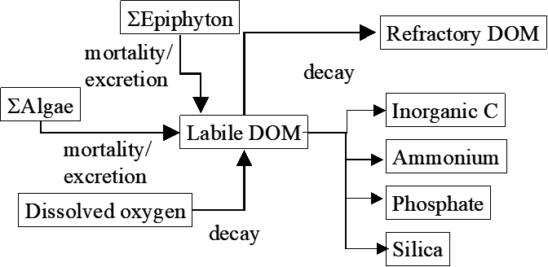
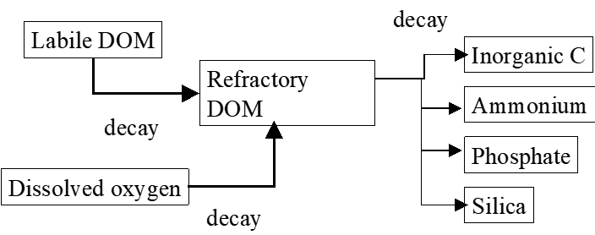
CE-QUAL-W2 Dissolved Organic Matter (DOM)

Slide 14
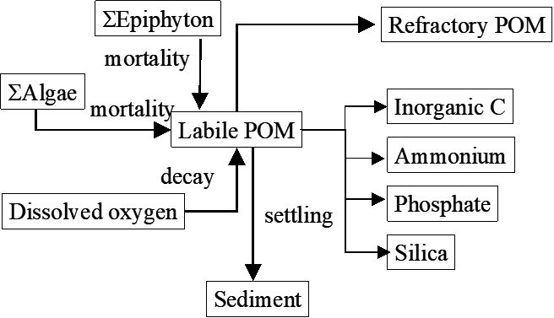
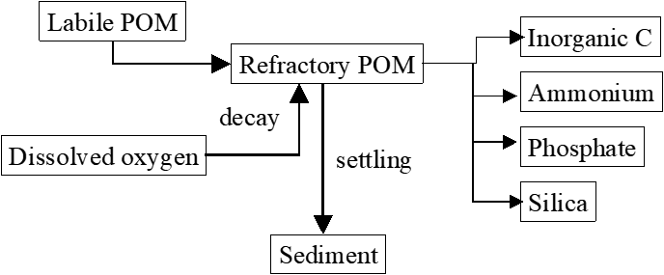
CE-QUAL-W2 Particulate Organic Matter (POM)

Slide 15
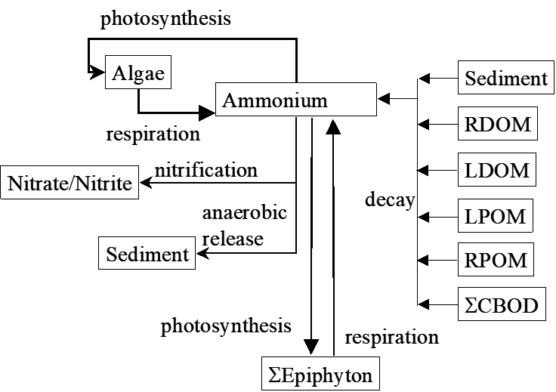
CE-QUAL-W2 Ammonium

Slide 16
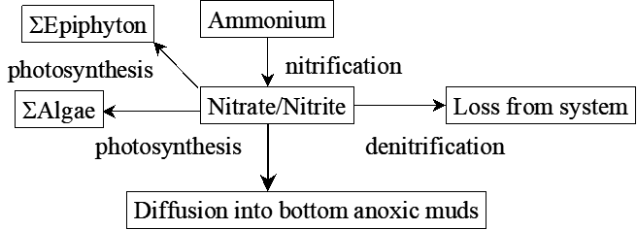
CE-QUAL-W2 Nitrate/Nitrite

Slide 17
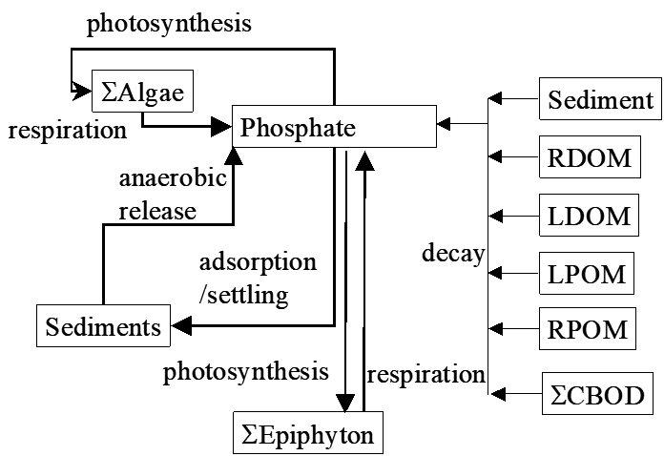
CE-QUAL-W2 Phosphate

Slide 18
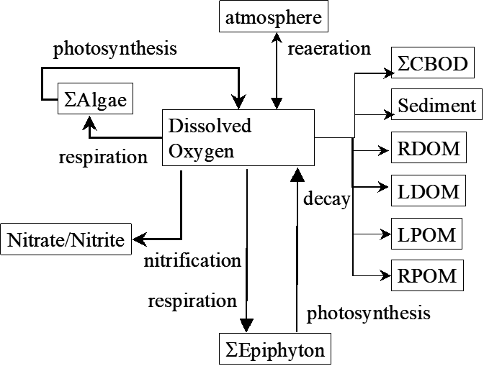
CE-QUAL-W2 Dissolved Oxygen (DO)

Slide 19
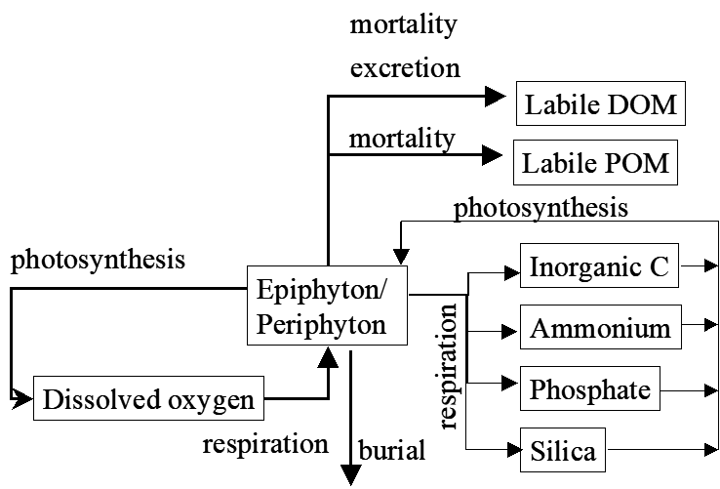
CE-QUAL-W2 Algae

Slide 20
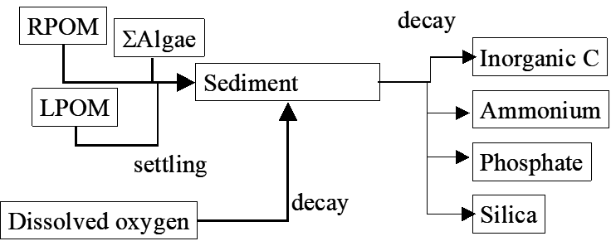
CE-QUAL-W2 Bed Sediment – First Order Approach
Notes:
In water quality modeling, first-order and second-order approaches refer to the types of differential equations and reaction kinetics used to describe the rates of processes affecting water quality constituents. These approaches are commonly applied to model the transformation and degradation of pollutants or substances in water bodies.
First-Order Approach
Definition:
- In a first-order approach, the rate of change of a substance concentration is directly proportional to the concentration of the substance itself. This approach is characterized by a linear relationship.
Mathematical Representation:
The general form of a first-order reaction rate equation is:
dC/dt= -kC
where:
- C is the concentration of the substance
- t is time
- k is the first-order rate constant (with units of time-1)
Characteristics:
- Linear Kinetics: The rate of decay or transformation of the substance decreases linearly with decreasing concentration.
- Simplified Assumptions: Assumes that other factors affecting the reaction rate are constant and do not change with time or concentration.
- Common Applications: Often used for modeling the decay of pollutants like organic contaminants, radioactive decay, and certain microbial processes.
Example:
The degradation of a pollutant in a river where the rate of decay depends solely on the pollutant concentration and a constant rate coefficient.
Second-Order Approach
Definition:
In a second-order approach, the rate of change of a substance concentration is proportional to the square of the concentration of the substance or the product of the concentrations of two reacting substances. This approach involves a quadratic relationship.
Mathematical Representation:
The general form of a second-order reaction rate equation can be:
dC/dt = -kC^2
for a single substance, or
d[A]/dt = -k[A][B]
where:
- [A] and [B] are the concentrations of the reacting substances
- t is time
- k is the second-order rate constant (with units of concentration⁻¹ and time⁻¹)
Characteristics:
- Quadratic Kinetics: The rate of reaction changes more rapidly as concentrations change, leading to non-linear dynamics.
- Interaction of Substances: Often involves interactions between two different substances or molecules.
- Complex Behavior: Can better represent more complex reactions where the rate is influenced by the concentrations of multiple reactants.
- Common Applications: Used for modeling processes like the reaction between dissolved oxygen and organic matter (biochemical oxygen demand), and the interaction between different pollutants or nutrients in water.
Example:
- The reaction between dissolved oxygen and organic matter in a water body where the rate of oxygen consumption depends on both the oxygen concentration and the organic matter concentration.
Key Differences
1. Order of Reaction:
- First-Order: Rate depends linearly on the concentration of one substance.
- Second-Order: Rate depends quadratically on the concentration of one substance or linearly on the product of the concentrations of two substances.
2. Rate Constants:
- First-Order: Has units of time⁻¹
- Second-Order: Has units of concentration⁻¹ and time⁻¹
3. Application Context:
- First-Order: Simplified, often for single-substance decay or simple microbial processes.
- Second-Order: More complex, often for reactions involving two substances or more intricate processes.
4. Modeling Complexity:
- First-Order: Easier to implement and solve due to its linear nature.
- Second-Order: More complex to implement and solve due to its non-linear nature.

Slide 21
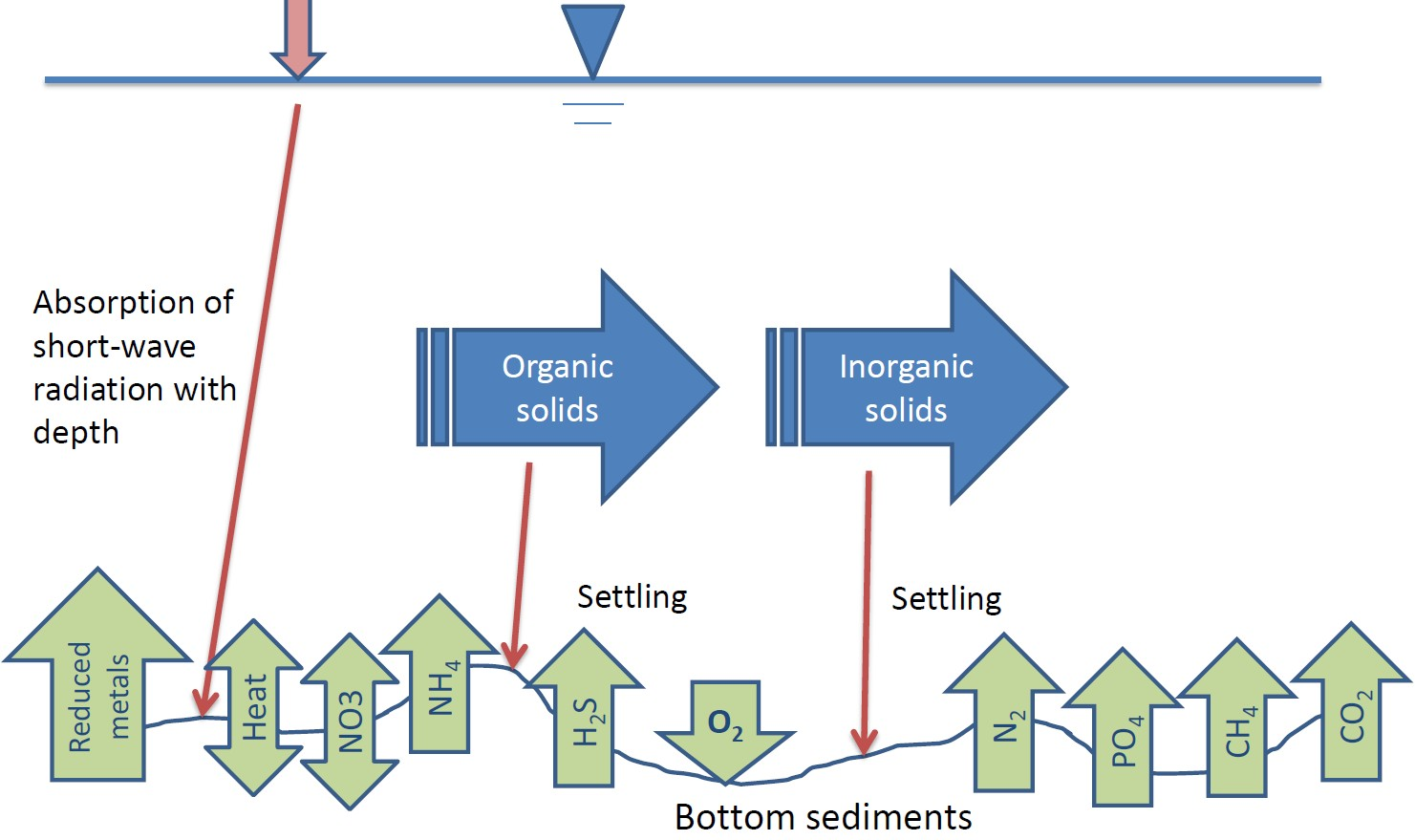
CE-QUAL-W2 Bed Sediment – Sediment Diagenesis Model

Slide 22
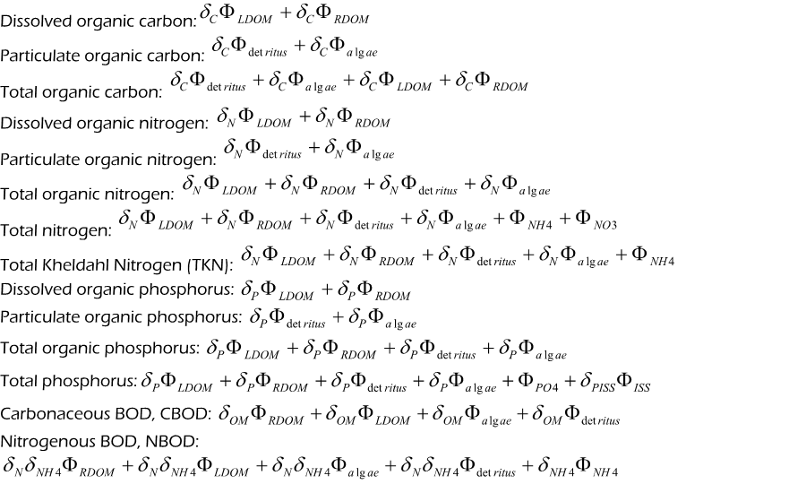
Conversions between CE-QUAL-W2 State Variables and Commonly Used
Field Data

Slide 23
Data Limitations
Availability and Quality of Data:
Insufficient Data: Lack of historical or real-time data for model calibration and validation.
Data Quality: Inaccuracies and inconsistencies in data collection methods, leading to unreliable inputs.
Spatial and Temporal Resolution: Inadequate resolution of data to capture local variations and short-term dynamics.
Missing Data: Gaps in data records can impede the development of accurate models.

Slide 24
Model Complexity and Assumptions
Simplified Representations:
Models often simplify complex physical, chemical, and biological processes, which can lead to oversimplification and loss of important details.
Assumptions and approximations may not always reflect real-world conditions accurately.
Parameter Estimation:
Difficulty in accurately estimating model parameters due to variability and uncertainty in natural systems.
Sensitivity of models to parameter values can lead to significant variations in output.

Slide 25



Questions?
UNCLASSIFIED
US Army Corps of Engineers •
Engineer Research and Development Center
UNCLASSIFIED
19

